Slide 1
Beaverfork Disc Golf Course Usage Forecasting
Joshua Jowers

Slide 2
Data Breakdown
The data is the monthly number of disc golf rounds recorded on the app Udisc from the Beaverfork disc golf course in Conway, AR
The training dataset is from January 2015-December 2018
The test dataset is from January 2019-December 2019

Slide 3
Time Series Plot of Data with train/test data split

Slide 4
Winters Method Summary
Initial S = 53.4
Initial G = 0.376085
Alpha = 1
Beta = 0.15
Gamma = 0.1

Slide 5
Lag Analysis (Box-Lyung)
K = (48/2 -2) = 22
N = 48
Top 4 autocorrelation lags:
Lag 1 (R = 0.4392)
Lag 2 (R = 0.2737)
Lag 15 (R = -0.2398)
Lag 16 (R = -0.21151)
Q = 21.2961
Chi-Square = 0.5025
Top 4 autocorrelation lags:
Lag 1 (R = 0.4392)
Lag 2 (R = 0.2737)
Lag 15 (R = -0.2398)
Lag 16 (R = -0.21151)

Slide 6
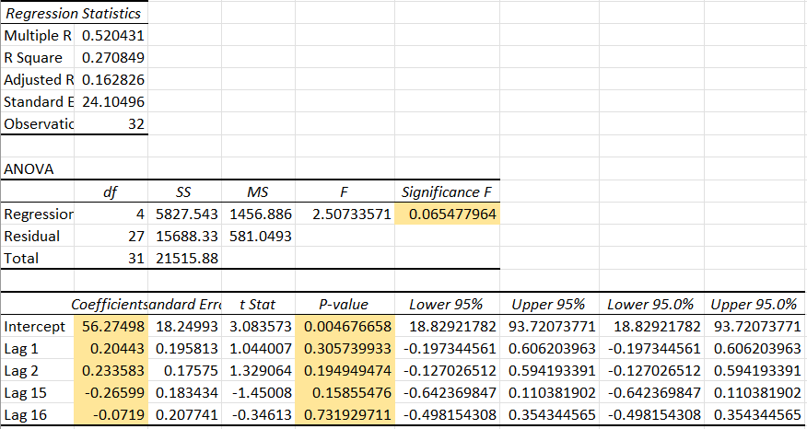
Autoregression Model

Slide 7
Model Comparison
Both models performed very poorly on my chosen dataset with MAPE values of 42% for Winters’ method and 51% for autoregression
Because of its slightly better performance of Winter’s method and its flexibility due to the parameters, I would choose Winter’s method over the autoregression model
I also think that with more data, Winter’s will improve more than the autocorrelation model, especially considering that none of the lags had a strong correlation with predicting the output
The autoregression model also seemed to be weak due to underfitting because it had no strong lag correlations
I didn’t feel like there was too much of a difference in effort required to justify that as the deciding factor between the two approaches
The data showed some seasonality that could be accounted for, but there are clearly other variables that prevent these methods from being successful

